Slide 1
Modern Architectures
Pravin Y Pawar

Slide 2
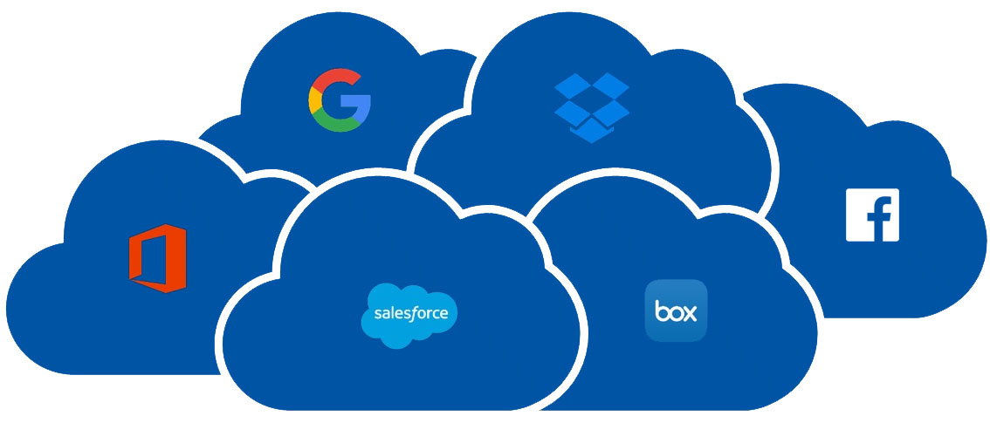
Approach
The cloud is changing how applications are designed and secured
Instead of monoliths, applications are decomposed into smaller, decentralized services
These services communicate through APIs or by using asynchronous messaging or eventing
Applications scale horizontally, adding new instances as demand requires
Requires a structured approach for designing applications that are
Scalable
Secure
Resilient
and highly available
These trends bring new challenges!
source : softeng

Slide 3

New challenges
Application state is distributed
Operations are done in parallel and asynchronously
Applications must be resilient when failures occur
Malicious actors continuously target applications
Deployments must be automated and predictable
Monitoring and telemetry are critical for gaining insight into the system
Source : prismetric

Slide 4
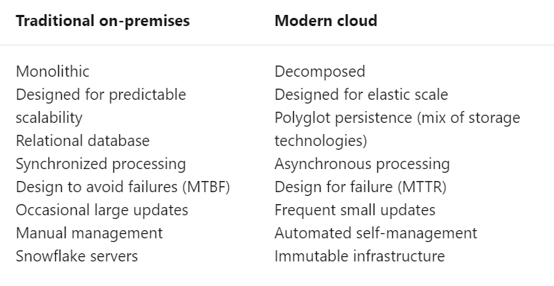
Compared
source : Microsoft

Slide 5
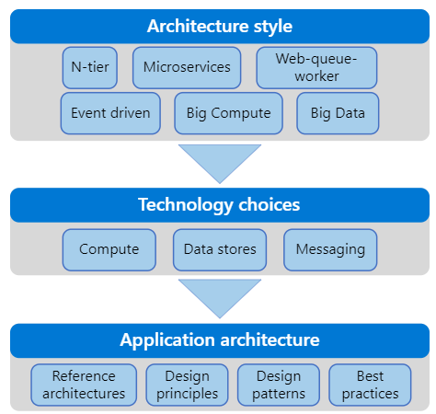
Structured Approach Needed
Series of steps, from the architecture and design to implementation are involved
For each step, there is supporting guidance needed to design application architecture
source : Microsoft

Slide 6
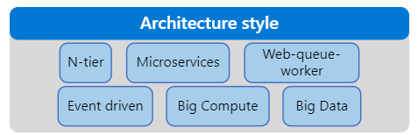
Architecture styles
The first decision point is the most fundamental
What kind of architecture are you building?
It might be
a microservices architecture,
a more traditional N-tier application,
or a big data solution
There are benefits and challenges to each.

Slide 7
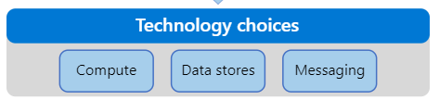
Technology choices
Now you can start to choose the main technology pieces for the architecture
Critical Technology choices are:
Compute
Data stores
Messaging
Compute refers to the hosting model for the computing resources that your applications run on
Data stores include databases but also storage for message queues, caches, logs, and anything else that an application might persist to storage
Messaging technologies enable asynchronous messages between components of the system
You will probably have to make additional technology choices along the way, but these three elements (compute, data, and messaging) are central to most cloud applications and will determine many aspects of your design.

Slide 8
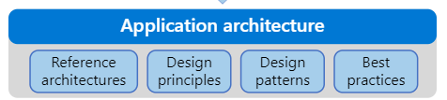
Application Architecture
Ready to tackle the specific design of your application
Every application is different, but the following resources can help you along the way:
Reference architectures
Design principles
Design patterns
Best practices
Reference architectures
Depending on your scenario, one of our reference architectures may be a good starting point
Each reference architecture includes recommended practices, along with considerations for scalability, availability, security, resilience, and other aspects of the design
Most also include a deployable solution or reference implementation.
Design patterns
Software design patterns are repeatable patterns that are proven to solve specific problems
They address aspects such as availability, high availability, operational excellence, resiliency, performance, and security

Slide 9
Thank You!
Reference:
Azure Application Architecture Guide
In our next session:

